Slide 1
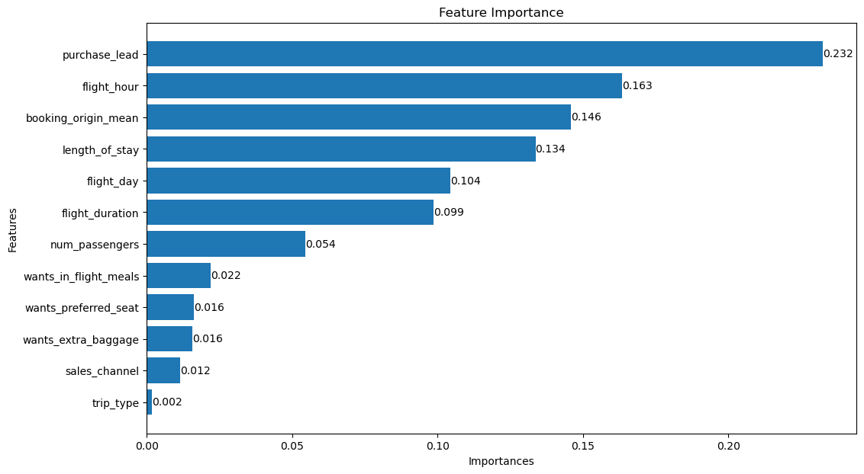
Purchase Lead: The difference between the number of days a customer searches for the flight and books it. Customers who purchase the flight closer to the departure date may be more likely to pay a higher price compared to those who booked well in advance, who may be more price sensitive.
Flight Hour: The hour of the day the flight is scheduled to depart. Flights departing at convenient hours are more likely to have a higher demand and therefore be priced higher compared to hours undesirable to the customers, which could be cheaper.
Booking Origin: Origin airport for the flight. Customers are more likely to purchase flights from airports that are closer to them geographically. Or certain airports may have better connections and/or more flight options, influencing customers’ buying behaviour.

Slide 2
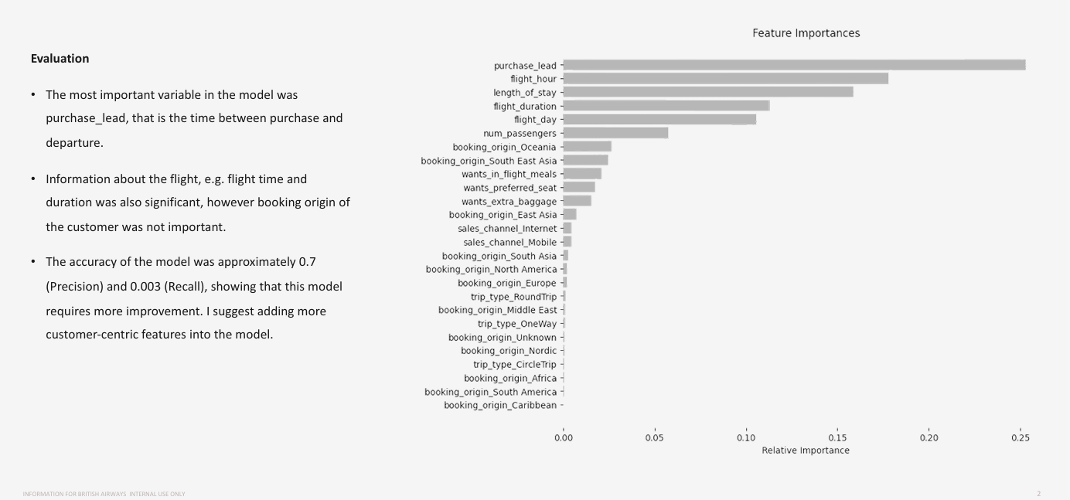
Model Answer

